Slide 1
Sample super store
Presented by
Narla Sandeep

Slide 2
Firstly, I will go through a data exploration to identify most important features and to explore the intercorrelation between features. After that I apply data normalization between variables and conduct feature engineering, Finally, I will be applying different machine learning algorithms and evaluating their respective success to a cross-validated splitted train-test set

Slide 3
As a business manager, try to find out the weak areas where you can work to make more profit.
From this we find which is best process to get a better output, by comparison between the
Log transformations.

Slide 4
By using jupyter notebook I read dataset by
taking samplesuper store as example.
In this I am done with all joint
plot,lmplot,scatter plot ,correlation and
normalization.
And also done the comparision between the log
and transformation process.
In this finding out the training and test data
with the help of sklearn model

Slide 5
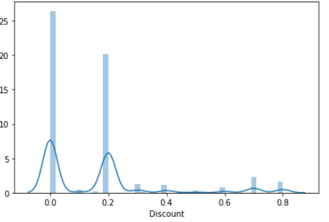
Histogram¶
In matplotlib we can create histogram using the method hist.

Slide 6
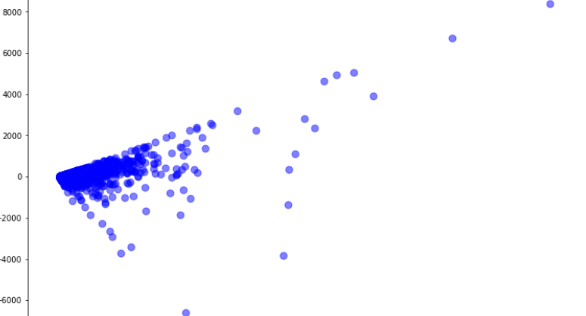
scatter plot
A scatter plot uses dots to represent values for two different numeric variables

Slide 7
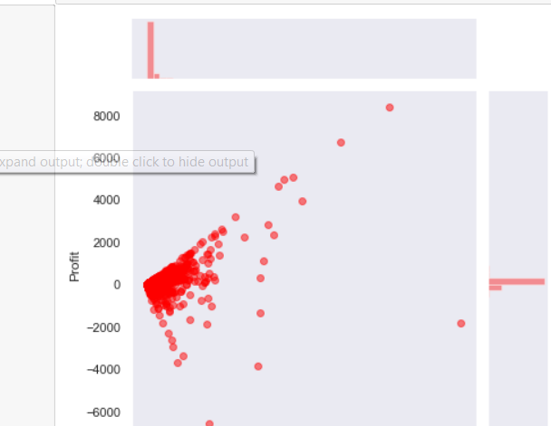
Joint plot:
The joint plot shows bi variant scatter plot and uni variate histogram in the same plot .
we will use seaborn library to create a joint plot

Slide 8
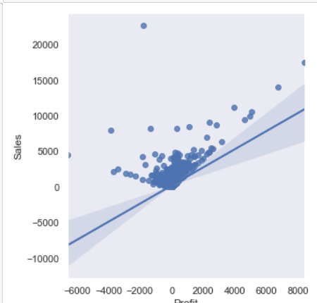
lmplot:
seaborn.lmplot() method is used to draw a scatter plot onto a FacetGrid.

Slide 9
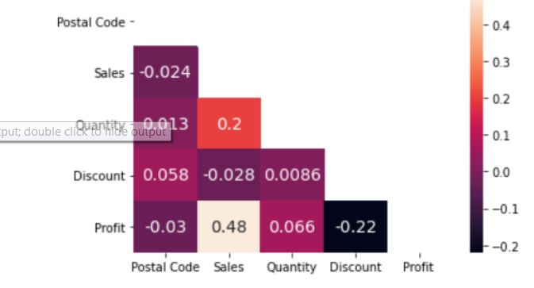
Heatmap
Heatmap provides realtime analytics to help chief editors and marketeers understand in seconds which are their best performing contents and which are less attractive to users.

Slide 10
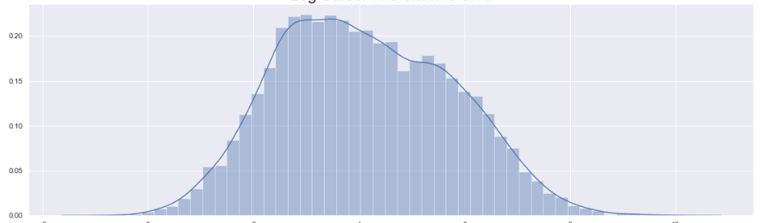
Normalization:
Where mean ,Median and mode are equal.

Slide 11
Results
Regression with log
Training data r-squared: 0.6182020584213566.........
Test data r-squared: 0.5473020484526968
Regression before transformation
Training data r-squared: 0.5395733078599285...........,
Test data r-squared: 0.17664260933911857

